Slide 1




NEXT GEN EMPLOYABILITY PROGRAM
Creating a future-ready workforce
Team Members
College Name
Student Name :Arockia Binolin S
Student ID :au960221243006
Arunachala College of Engineering for Women

Slide 2

CAPSTONE PROJECT SHOWCASE
Project Title
Car Rentals Application with Django Framework
Abstract | Problem Statement | Project Overview | Proposed Solution | Technology Used | Modelling & Results | Conclusion

Slide 3
Abstract
The car rental industry has undergone a remarkable evolution propelled by digitalization and technological advancements. Traditionally reliant on manual processes and physical transactions, the sector now thrives on digital platforms and innovative solutions. Online reservation systems, mobile applications, and GPS navigation have revolutionized customer experiences, offering seamless booking, real-time tracking, and personalized services. Moreover, data analytics and machine learning algorithms optimize fleet management and pricing strategies, while IoT devices and telematics solutions ensure vehicle safety and reliability. Embracing electric and autonomous vehicles further signifies a shift towards sustainable mobility solutions. However, to fully harness the potential of digital transformation, rental agencies must prioritize cybersecurity, data privacy, and continuous technological innovation to remain competitive in an ever-evolving marketplace.
Source :

Slide 4
Problem Statement
The car rental industry faces several pressing challenges despite the rapid integration of digital solutions. These include fragmented user experiences stemming from inconsistent service offerings across platforms, complex pricing structures causing customer confusion, and difficulties in managing fleet availability across multiple locations. Ensuring the reliability and maintenance of vehicles, especially with the adoption of IoT and autonomous technologies, poses additional hurdles. Moreover, heightened concerns regarding data security and privacy necessitate robust cybersecurity measures. Addressing these challenges is crucial for rental agencies to provide seamless experiences, optimize operations, and maintain competitiveness in an increasingly digital and interconnected marketplace.
Source :

Slide 5
Project Overview
This project aims to address the challenges faced by the car rental industry through the development and implementation of comprehensive digital solutions. The overarching goal is to enhance customer experiences, streamline operational processes, and ensure the sustainability and competitiveness of rental agencies in the evolving mobility landscape.
The project will focus on several key areas:
Digital Platform Development
Optimized Pricing Strategies
Fleet Management and Optimization
Customer Relationship Management
Cybersecurity and Data Privacy
Sustainability Initiatives
Source :

Slide 6
Proposed Solution
.
Our solution revolves around the development and integration of a comprehensive digital ecosystem tailored to address the specific challenges of the car rental industry. This ecosystem encompasses a user-friendly online platform and mobile application for seamless booking experiences, dynamic pricing algorithms to optimize revenue and transparency, IoT-enabled fleet management systems for real-time vehicle tracking and maintenance, and robust customer relationship management tools for personalized interactions. Moreover, stringent cybersecurity measures will be implemented to safeguard customer data and ensure privacy. Additionally, we propose exploring sustainability initiatives such as integrating electric and autonomous vehicles into the fleet to promote environmental responsibility. Through these strategic initiatives, our solution aims to revolutionize the car rental experience, delivering enhanced convenience, efficiency, and sustainability while maintaining a competitive edge in the digital era.
Source :

Slide 7
Scope
Development of user-friendly online platform and mobile application for seamless booking experiences.
Implementation of dynamic pricing algorithms to optimize revenue and enhance transparency.
Integration of IoT-enabled fleet management systems for real-time vehicle tracking and maintenance monitoring.
Deployment of robust customer relationship management tools for personalized interactions and enhanced customer satisfaction.
Implementation of stringent cybersecurity measures to safeguard customer data and ensure privacy.
Exploration of sustainability initiatives including the integration of electric and autonomous vehicles into the rental fleet.
Continuous monitoring and improvement of digital solutions to adapt to evolving industry trends and customer needs.
Source :

Slide 8
Functional and Non Functional Reqirements
Functional Requirements:
Booking System: Enable users to search, select, and book vehicles easily.
Payment Processing: Support secure payment transactions using various methods.
Fleet Management: Provide tools for administrators to manage vehicles, availability, and tracking.
Customer Management: Allow for the creation and management of customer profiles.
Reporting and Analytics: Offer insights into key performance metrics.
Non-functional Requirements:
Usability: Ensure an intuitive and user-friendly interface.
Performance: Maintain high performance under heavy loads.
Security: Implement robust measures to protect customer data.
Reliability: Minimize downtime and errors.
Scalability: Design for seamless scalability to accommodate growth.
Source :

Slide 9


Technology Used
Front-end
Back-end
Source :

Slide 10
Modelling & Results
System Design:
Utilize UML diagrams for system modeling.
Adopt a modular architecture for scalability.
Design a relational database schema.
Choose appropriate frontend, backend, and database technologies.
Development:
Follow an agile methodology with iterative sprints.
Use version control for collaborative development.
Implement coding standards and automated testing.
Integrate third-party services via APIs.
Testing:
Conduct unit, integration, and performance testing.
Collaborate with stakeholders for UAT.
Perform security assessments and penetration testing.
Deployment:
Automate deployment with CI/CD pipelines.
Deploy to cloud or on-premises infrastructure.
Implement monitoring tools for system health.
Plan for regular maintenance and updates.
Source :

Slide 11
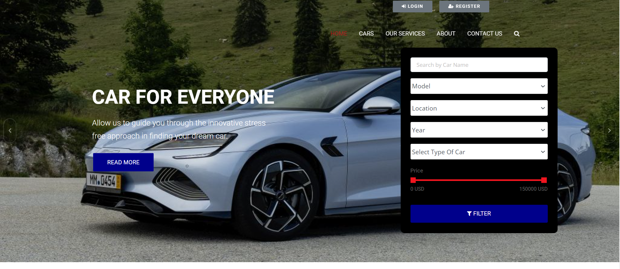
Homepage

Slide 12
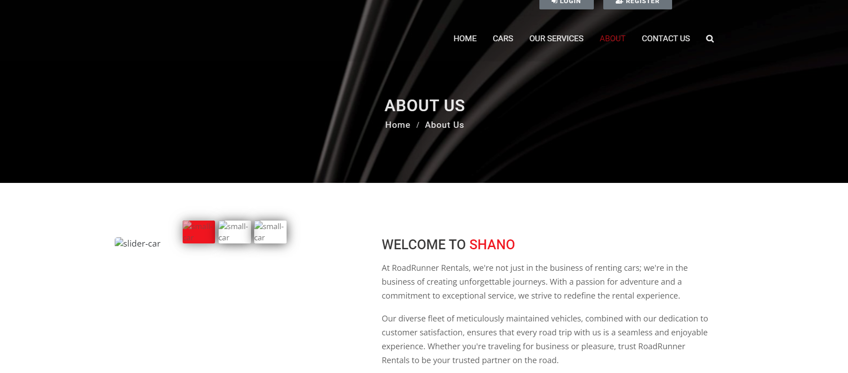
About-Us-Page

Slide 13
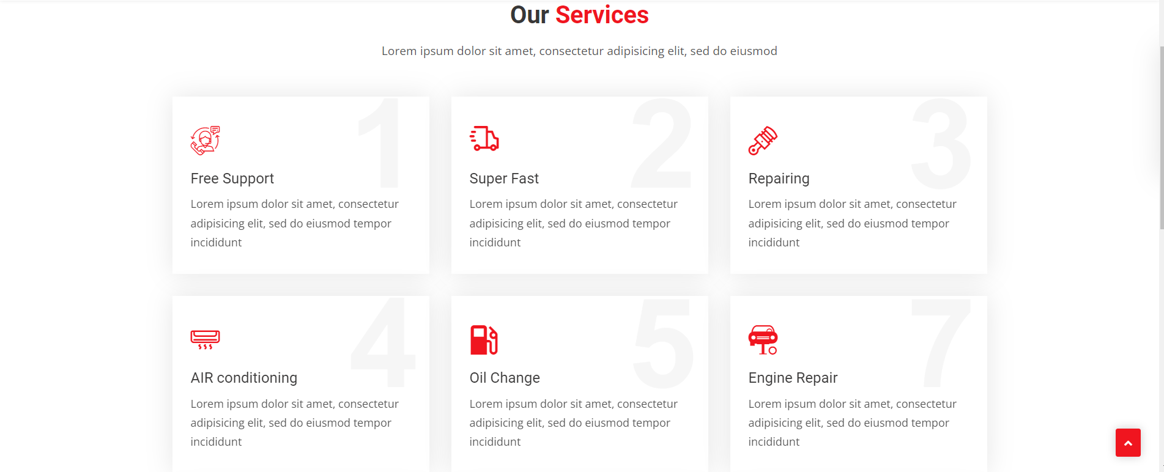
Service-Page

Slide 14
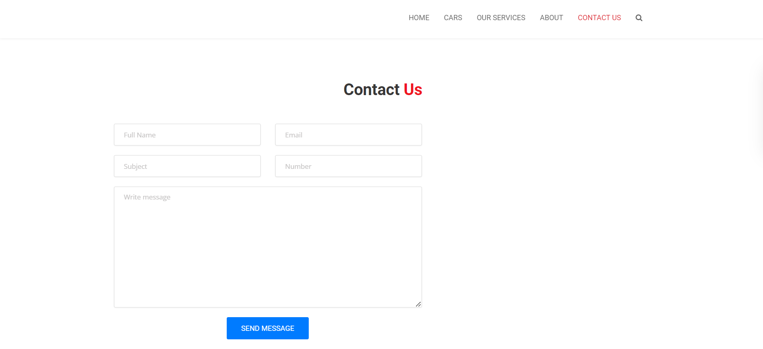
Blog-Page

Slide 15
Future Enhancements:
Predictive Analytics: Forecast demand and optimize pricing.
Enhanced Personalization: Provide tailored recommendations.
Augmented Reality (AR) Features: Offer interactive vehicle tours.
Blockchain for Security: Ensure transparent transactions.
Voice Recognition: Enable hands-free interactions.
Sustainability Initiatives: Expand eco-friendly practices.
Integration with Smart Cities: Collaborate with urban mobility.
Partnerships and Loyalty Programs: Offer integrated booking experiences.
Expansion into New Markets: Explore geographical expansion.
Continuous Improvement: Gather and analyze customer feedback.

Slide 16
Conclusion
In conclusion, the proposed digital solutions offer a promising path forward for the car rental industry, addressing current challenges and unlocking new opportunities for growth and differentiation. Through the integration of user-friendly platforms, advanced analytics, and cutting-edge technologies like IoT and AR, rental agencies can enhance customer experiences, optimize operations, and drive sustainable business practices. By embracing innovation, maintaining a customer-centric approach, and fostering collaboration within the ecosystem, the industry is poised to thrive in an era of rapid digital transformation, delivering value and convenience to customers while maintaining a competitive edge in the market.
Continued investment in technological advancements, strategic partnerships, and a commitment to continuous improvement will be essential for rental companies to stay ahead of evolving customer expectations and market trends. By embracing these principles and leveraging the full potential of digitalization, the car rental industry can navigate challenges, seize opportunities, and emerge as a leader in the mobility landscape of the future.
Source :

Slide 17
Thank You!
Notes:
Thank You !!

